Slide 1
Quality Assurance
27th September 2014

Slide 2
Introduction
Agile (SCRUM) helps us to bring QA into the product development cycle early.
QA is embedded throughout the whole development process.
The following are areas to highlight when trying to achieve this:
QA Agile Testing Process
Test Driven Development
Continuous Integration
Metrics
Automation

Slide 3
Agile continuous improvement
Any Agile process is not perfect
This is definitely true for ours
Focus is on continuous improvement
Sprint retrospectives, team retrospectives, project retrospectives
Review what works, and what is not working
Look at how we can improve things
We still have a long way to go
More automation, better stories, more metrics, fast releases…
Notes:
Please note, in terms of Agile, we are not perfect and are still continually improving the way we do it. What we explain here is a snapshot of where we are, and in some instances where we are aiming to be.

Slide 4
QA Agile Testing Process
Sprint Planning:
QA are fully integrated into the whole of the Agile development process…..
A story is entered into Team Foundation Server (TFS) as an unapproved Product Backlog Item
Somebody adds a new story
1
New
Notes:
At Arieso, QA are an integral part of the Agile SCRUM team and attend Sprint planning meetings along with the Developers and the Product Manager, at the start of each 2 week Sprint.
This meeting is where the Team decide what work we are going to commit to deliver by the end of the Sprint.
Either before or during the meeting, a Story (which is a product feature to be implemented by the team) is entered into Team Foundation Server as an unapproved Product Backlog Item.

Slide 5
QA Agile Testing Process
Sprint Planning:
QA are fully integrated into the whole of the Agile development process…..
During the planning meeting, Stories are prioritised and Approved
The team estimate and agree the size of the story based on previous experience
Somebody adds a new story
1
2
Approved
New
Product Manager agrees the story should be done and prioritises it
Notes:
During the meeting, Stories are Approved and given a priority by the Product Manager. The team estimate and agree the size of the story based on previous experience. This is not a time estimate!

Slide 6
QA Agile Testing Process
Sprint Planning:
QA are fully integrated into the whole of the Agile development process…..
Somebody adds a new story
Product Backlog
1
2
Approved
New
Added to product backlog
Product Manager agrees the story should be done and prioritises it
Once several Stories are estimated, the team can decide how much work will fit into the Sprint
Notes:
Once we have several estimated stories, the team can decide how much work we can fit into the Sprint. We then assign the Stories to the backlog for the coming Sprint

Slide 7
QA Agile Testing Process
Sprint Planning:
QA are fully integrated into the whole of the Agile development process…..
Somebody adds a new story
Product Backlog
1
2
Approved
New
Added to product backlog
Product Manager agrees the story should be done and prioritises it
PM and Dev team commit to delivery this Sprint
3
The chosen stories are “committed” to be completed by the end of the Sprint
Committed
Notes:
The chosen stories are “committed” to be completed by the end of the Sprint. This commitment is taken very seriously by the whole team.
Tasks (including test tasks) are assigned to each “committed” Product Backlog Item in Team Foundation Server and the team agrees actual hours against them.

Slide 8
QA Agile Testing Process
During the Sprint:
Test plans are written in parallel with software development
Test failures are either fixed during the Sprint or recorded as bugs in TFS
Product Backlog
Added to product backlog
PM and Dev team commit to delivery this Sprint
3
Committed
Work Started
Developed
(Implemented and tested)
4
Notes:
During the Sprint:
Test plans are written in parallel with software development, in “Microsoft Test Manager”.
Test plans are discussed with the Developer, as the code is written.
Tests are executed as soon as development is complete.
Test failures are either fixed during the Sprint or recorded as bugs in TFS.
Bugs are fixed via the Bug Review Process.

Slide 9
QA Agile Testing Process
A Story is “Done” when:
All QA Tasks are complete
Product Management approve the story
Product Backlog
Added to product backlog
PM and Dev team commit to delivery this Sprint
3
5
Done
Committed
Product Manager approves the feature
Work Started
Developed
(Implemented and tested)
4
Notes:
A Product Backlog Item is not marked as “Done” in TFS until:
All QA Tasks are complete.
Any bugs reported are fixed and verified by QA, or a concession is agreed with the Product Manager.
Product Management approval has been obtained.

Slide 10
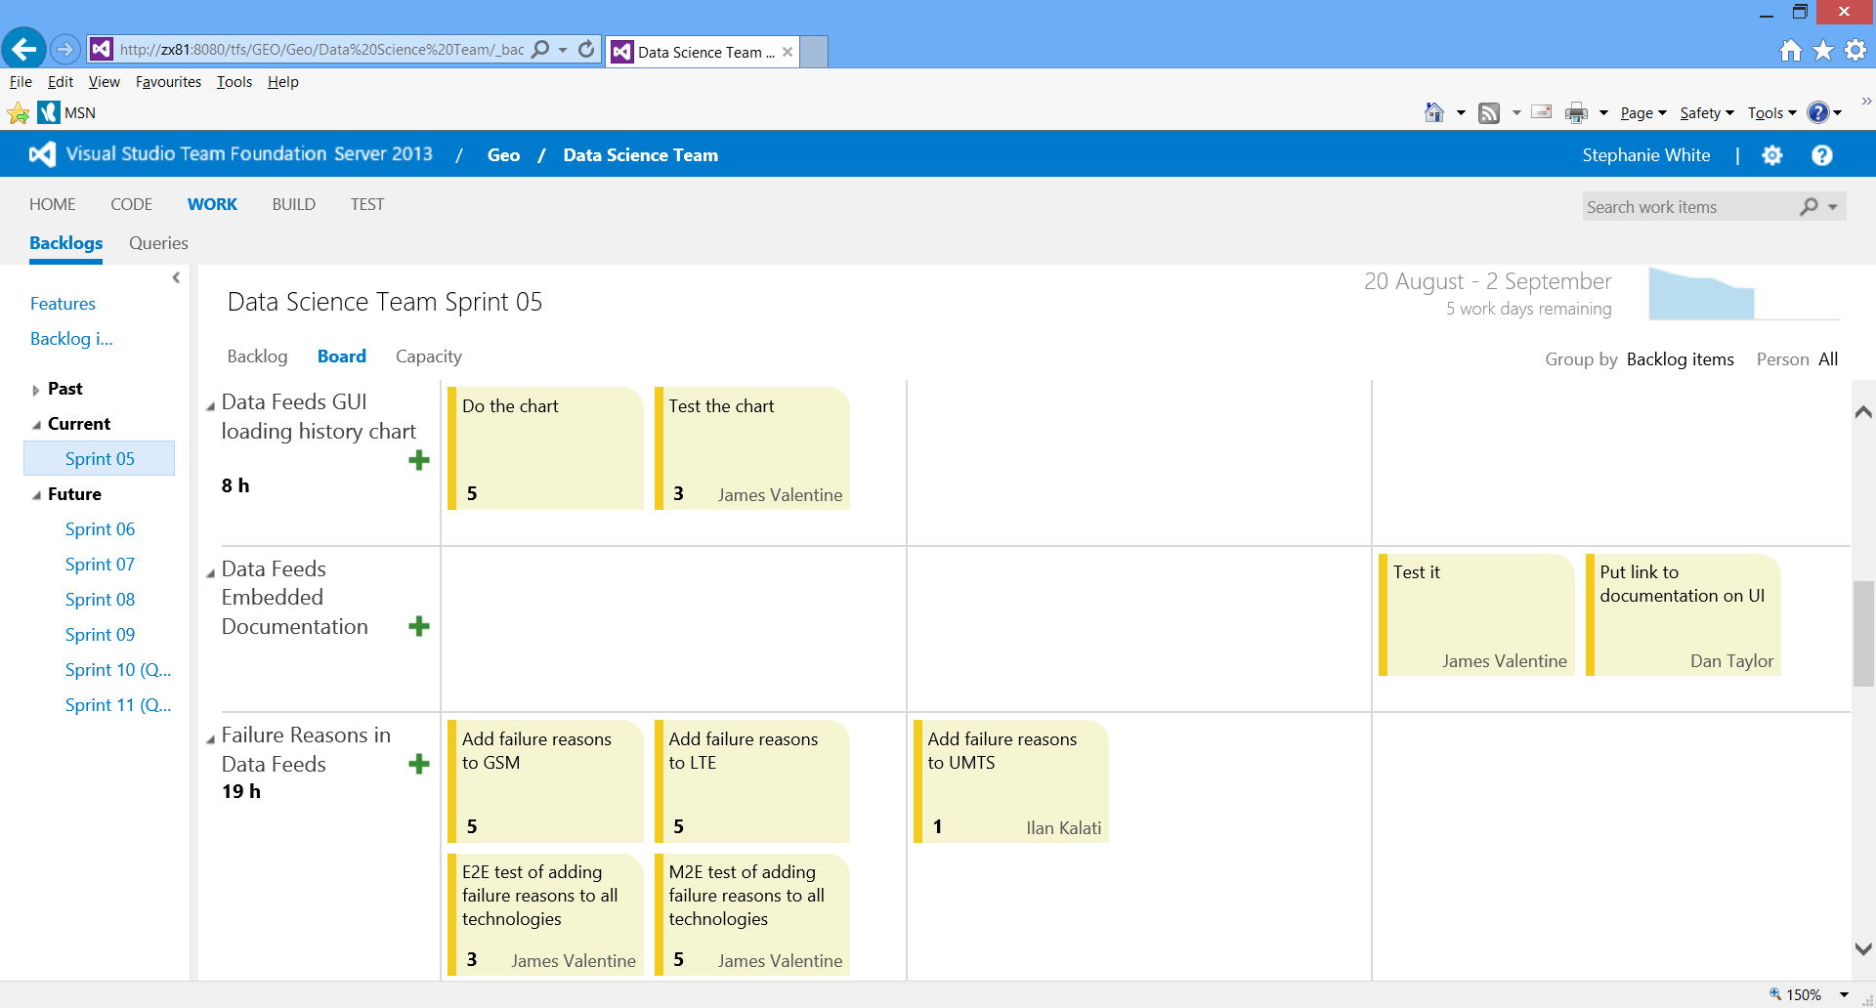
TFS - Demo
http://zx81:8080/tfs/GEO/Geo/Data%20Science%20Team/_backlogs/TaskBoard#_a=requirements

Slide 11
QA Agile Testing Process
Key Benefits:
Increased quality:
Close collaboration reduces risk of missed test scenarios.
Testing is a continuous activity during the Sprint and not an after-thought.
Highly adaptable to change.

Slide 12
Behaviour Driven Development
Approved
Product Backlog
New
Misunderstandings here are costly
Committed
Done
Developed
(Implemented and tested)

Slide 13
Test Driven Development
Software tests within the codebase
Run after every code change
Aim to test every code path
Protects against “accidental damage”
Drives good design
Builds confidence

Slide 14
Test Coverage (%)

Slide 15
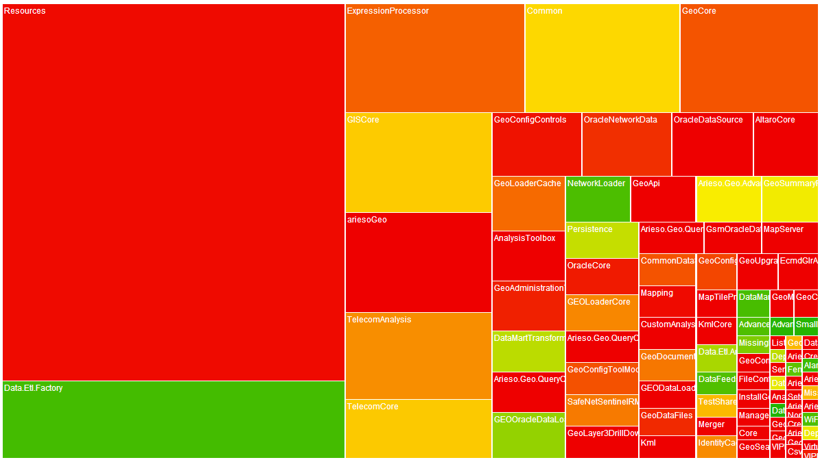
Test Coverage Detail

Slide 16
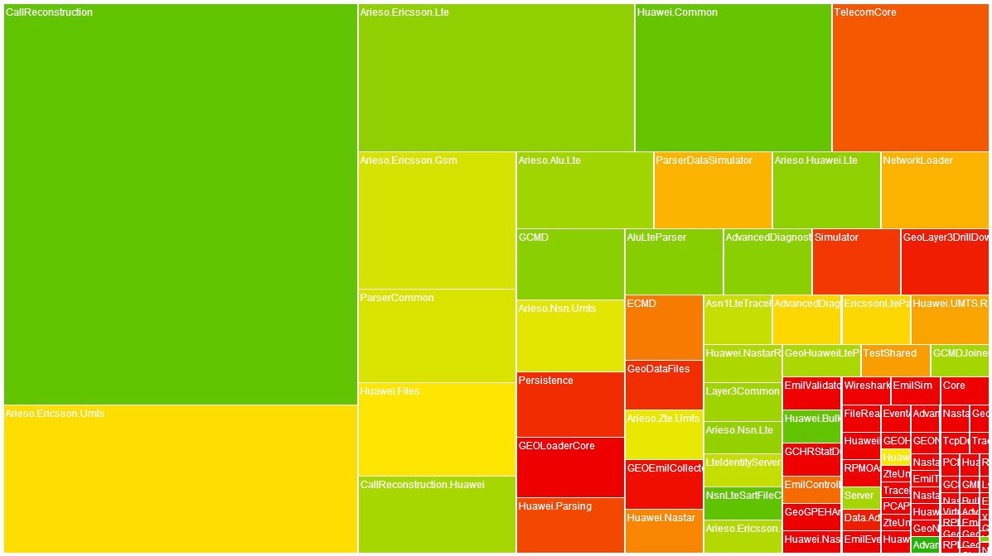
Test Coverage Detail

Slide 17
Behaviour Driven Development
Approved
Product Backlog
New
Misunderstandings here are costly
Committed
Done
Developed
(Implemented and tested)

Slide 18
Behaviour Driven Development
Agree the specification with the Product Owner
Implement the solution
Test the solution against the specification itself
On the engineer’s desk and…
Every time any code is edited
20-30 times a day
Forever

Slide 19
An Example BDD Scenario
Feature: SpecFlowFeature1
In order to avoid silly mistakes
As a math idiot
I want to be told the sum of two numbers
Scenario: Add two numbers
Given I have entered 50 into the calculator
And I have entered 70 into the calculator
When I press add
Then the result should be 120 on the screen

Slide 20
A Real BDD Scenario
Scenario: Summarised items are grouped by XBin and YBin
When I transform GSM call segment data
| XBin | YBin | Segment |
| 0 | 0 | 0 |
| 0 | 0 | 0 |
| 50 | 50 | 0 |
| 50 | 50 | 0 |
| -50 | -50 | 0 |
And I retrieve the Hourly GSM Bin Summary results
Then the GSM bin summary results are
| XBin | YBin | Calls |
| 0 | 0 | 2 |
| 50 | 50 | 2 |
| -50 | -50 | 1 |

Slide 21
Continuous Integration
BDD and Unit Tests run against every code change
Currently 15,000+ are run 20-30 times a day
Broken tests prevent creation of build artefacts

Slide 22
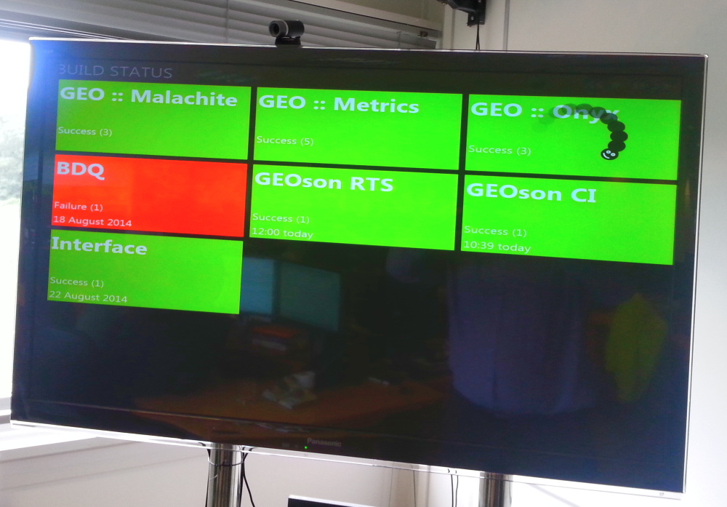
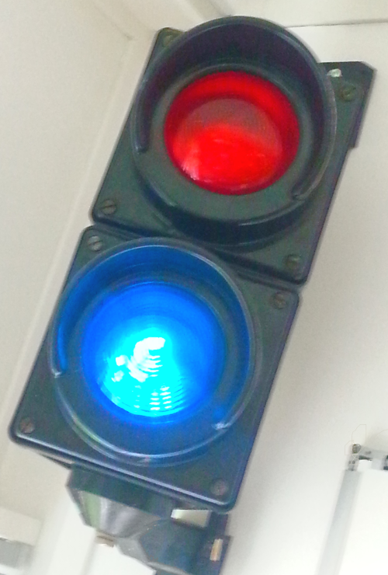
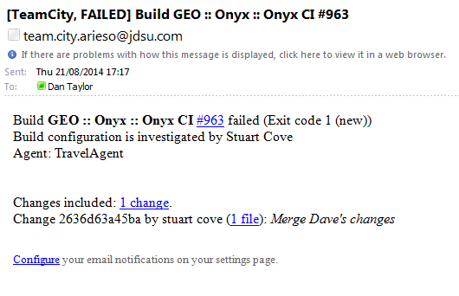
Continuous Integration

Slide 23
Metrics
Test/Spec Coverage monitored daily using a 3rd party tool
Teams push for continuous improvement overall
Minimum of 70% coverage required on all new code
Routinely achieving 80-90% with BDD

Slide 24
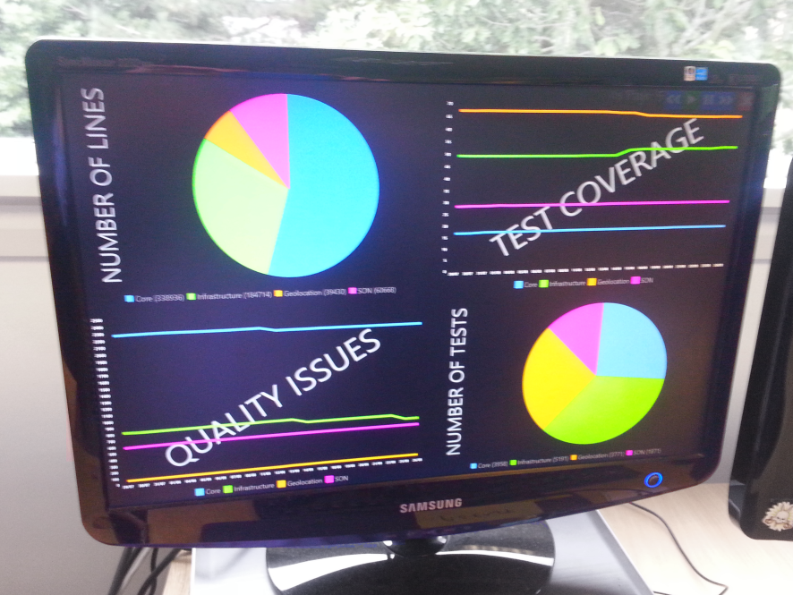
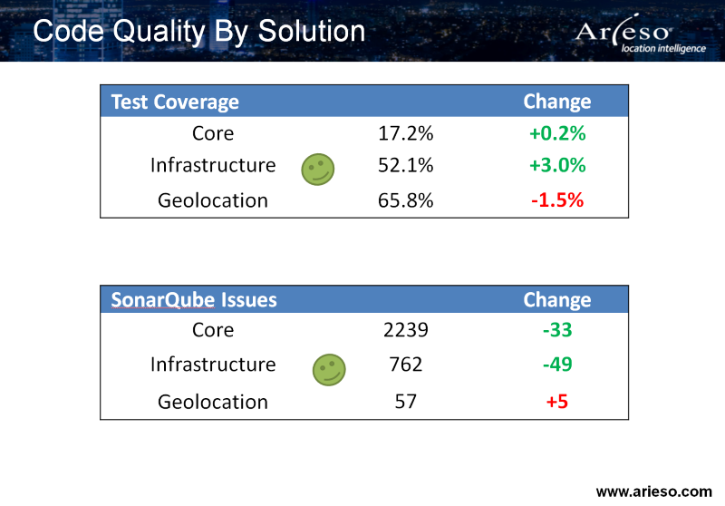
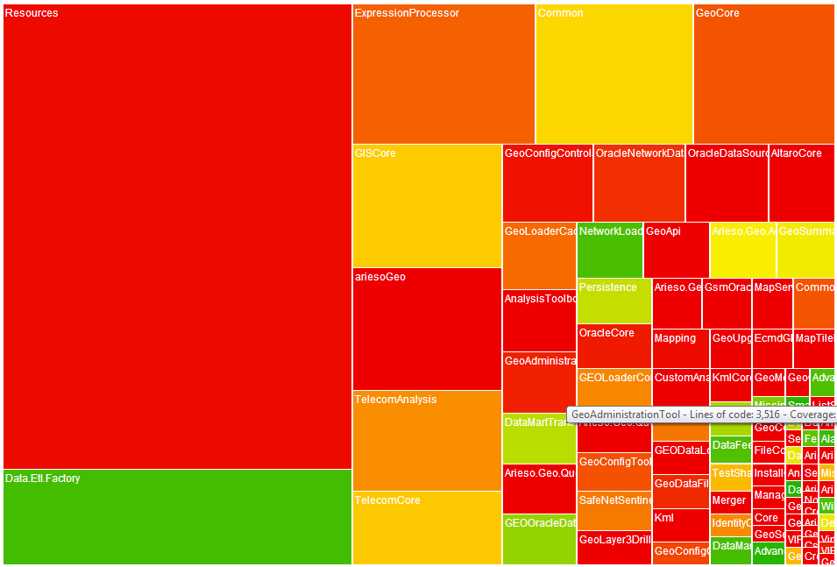

Metrics - Demo

Slide 25
Test Automation - Overview
Loader Chain Automation
Comparing the output of the ariesoGEO loader chain against a known baseline
Analyses Automation
Comparing the output of ariesoGEO product Analyses against a known baseline
Call Data Sets for all Supported Technologies and Vendors
Custom Framework in C#
Baseline Editor
Charts Website
Weekly Report
nUnit
TeamCity
Notes:
2 groups of test
Group 1: Loader Chain Automation
Comparing the output of the ariesoGEO loader chain against a known baseline
Custom Framework written in C#
ariesoGEO Performance is treated as a black box
allows us to automate the ariesoGEO Performance Loader Chain executables
Passing required arguments to components, starting/stopping components and monitoring them when they are running
manages test environment preparation and setup required for the tests to run including product installation
allows us to compare the contents of loader chain output (database and file system) with a known baseline of expected results
nUnit tests fail if the actual result differs from the expected result by more than the expected margin (expected margins are defined on a per test basis)
test results are available to be viewed in TeamCity, a custom Test Results Website and a automatically generated weekly report
Group 2: Analyses Automation
Comparing the output of ariesoGEO product analyses against a known baseline
Builds on the Loader Chain Automation framework, also written in C#
ariesoGEO Performance is treated as a black box
allows us to automate the ariesoGEO Performance Product Analyses
Controls the analyses shipped in the product using the ariesoGEO Performance API
manages test environment preparation and setup required for the tests to run
allows us to compare the contents of analyses output (database and file system) with a known baseline of expected results
nUnit tests fail if the actual result differs from the expected result by more than the expected margin
test results visible in TeamCity

Slide 26






Test Automation – Using the Tests
Small Data Sets (2h)
Loader Chain : All Technologies and Vendors
Every Morning
DEV
Medium Data Sets (4h)
Loader Chain : All Technologies & Vendors
Every Night
DEV
Large Data Sets ( > 4 h)
Loader Chain : All Technologies & Vendors
Analyses Automation Tests
Bi-Weekly
DEV
Feedback Time
6 test environments
c. 85% agent utilisation
Windows Server 2008 / 2012

Slide 27
Round-up
We can get QA involve throughout the development cycle, for both bugs and new features. (Tool shown: TFS)
Continuous Integration helps us to continually run our Unit and BDD scenario test cases, picking up issues early. (Tool shown: Team City)
We can measure our test coverage and code quality. (Tool shown: SonarQube)
We consider and include automation throughout the whole product.
Notes:
Therefore,
Agile allows to adapt to change or customer requirements, yet still giving us the ability to do QA well.
Most importantly, with the retrospectives in Agile we can strive to improve all of the above.

Slide 28
Test Automation – Running The Tests
New build created
Tests triggered automatically
DEV
Multiple Build Agents testing multiple product versions
QA
QA
DEV
Baseline Updated / Bugs Raised
Test Results Reviewed
Notes:
We are continuously integrating so several new builds of ariesoGEO Performance are created as a result of code change and each build includes a product installer
Automated tests are triggered on a daily schedule and each time they are triggered they test the latest build of product available
All the tests are ran against the latest version of the product and the test results are reviewed
The test results are reviewed and any discrepancies in the test results are investigated by both development and QA to determine the reason why the expected result does not equal the baseline
2 outcomes
Product bug is raised (change in result not expected)
Actual result is correct and a product change is identified as the cause for the change in result
Loader chain test suite takes around 100 hours to complete, we manage the impact of high total test time with the need for regular test runs by using multiple virtualised test environments in parallel.
By running the tests frequently we reduce the feedback time on a change that is made to the product code, resulting in early visibility of changes in behaviour

Slide 29
Life Cycle of a Story
Somebody adds a new story
1
Approved
Product Backlog
New
2
Product Manager agrees the story should be done and prioritises it
Added to product backlog
PM and Dev team commit to delivery this Sprint
3
5
Committed
Done
Product Manager approves the feature
4
Developed
(Implemented and tested)
Work Started

Slide 30
Lifecycle of a bug
Bug added
3
Approved
Product Backlog
1
2
New
Bug Review Board agree bug is valid and assign a priority
BRB or Maintenance Engineer commits the bug to a release
4
Committed
Engineer Fixes the bug
Done
In Progress
5
QA agree issue is resolved
7
QA/Test
6

